Slide 1
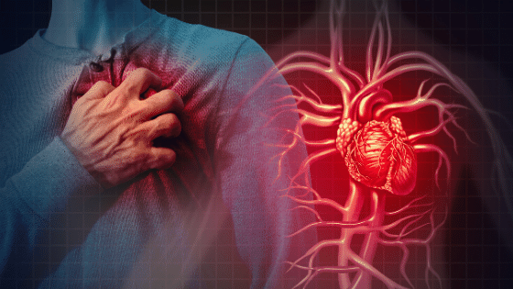
Cardiovascular
Disease
Manar Almohaimeed

Slide 2
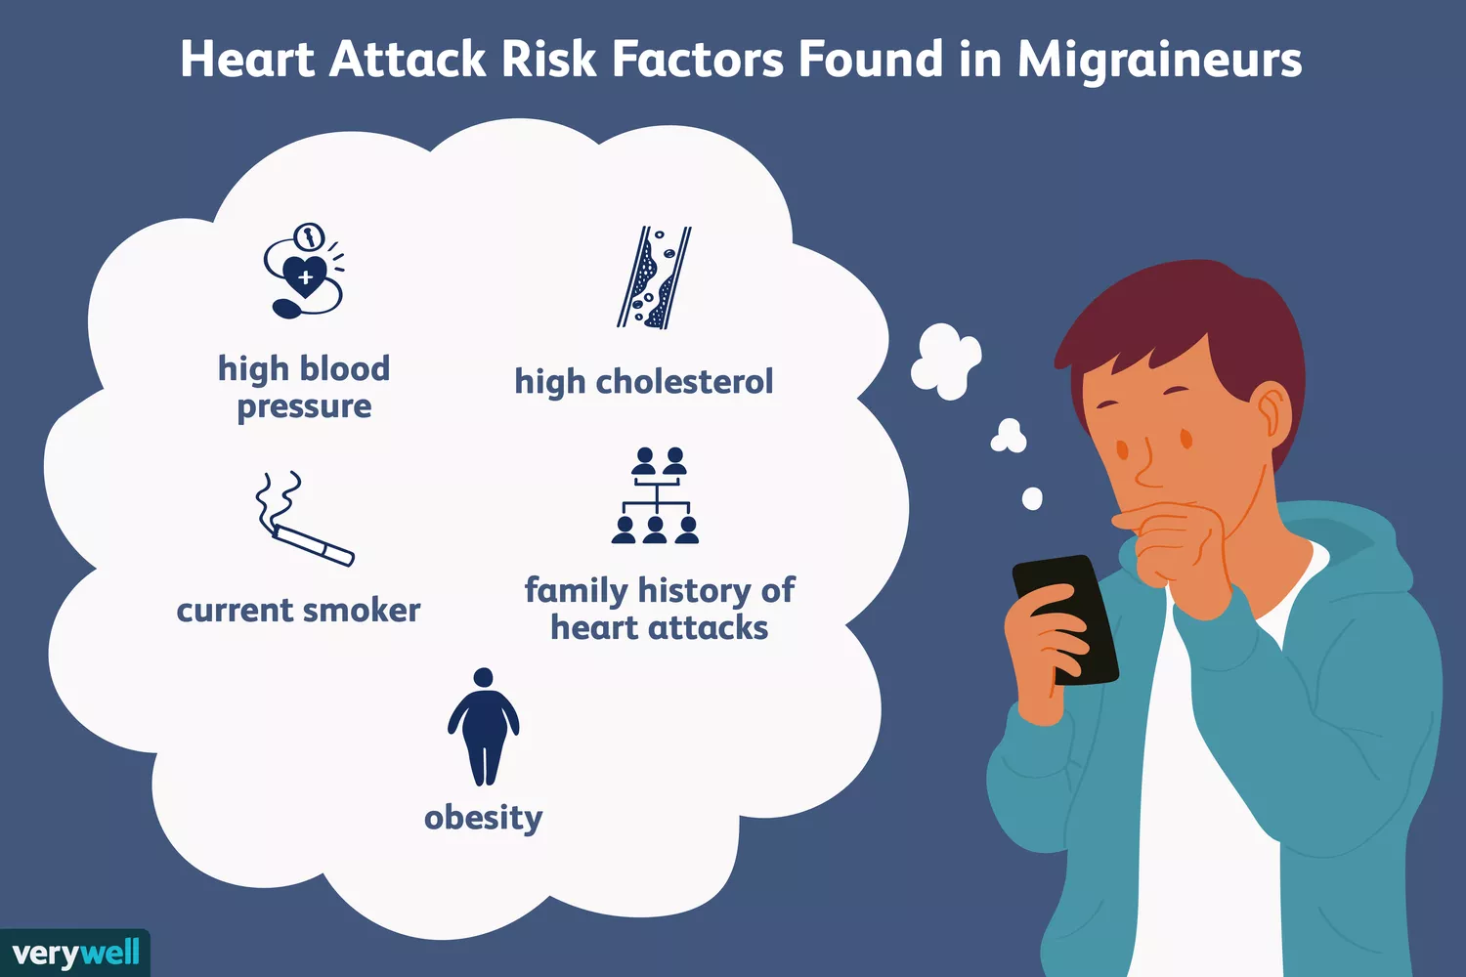


WHY?

Slide 3
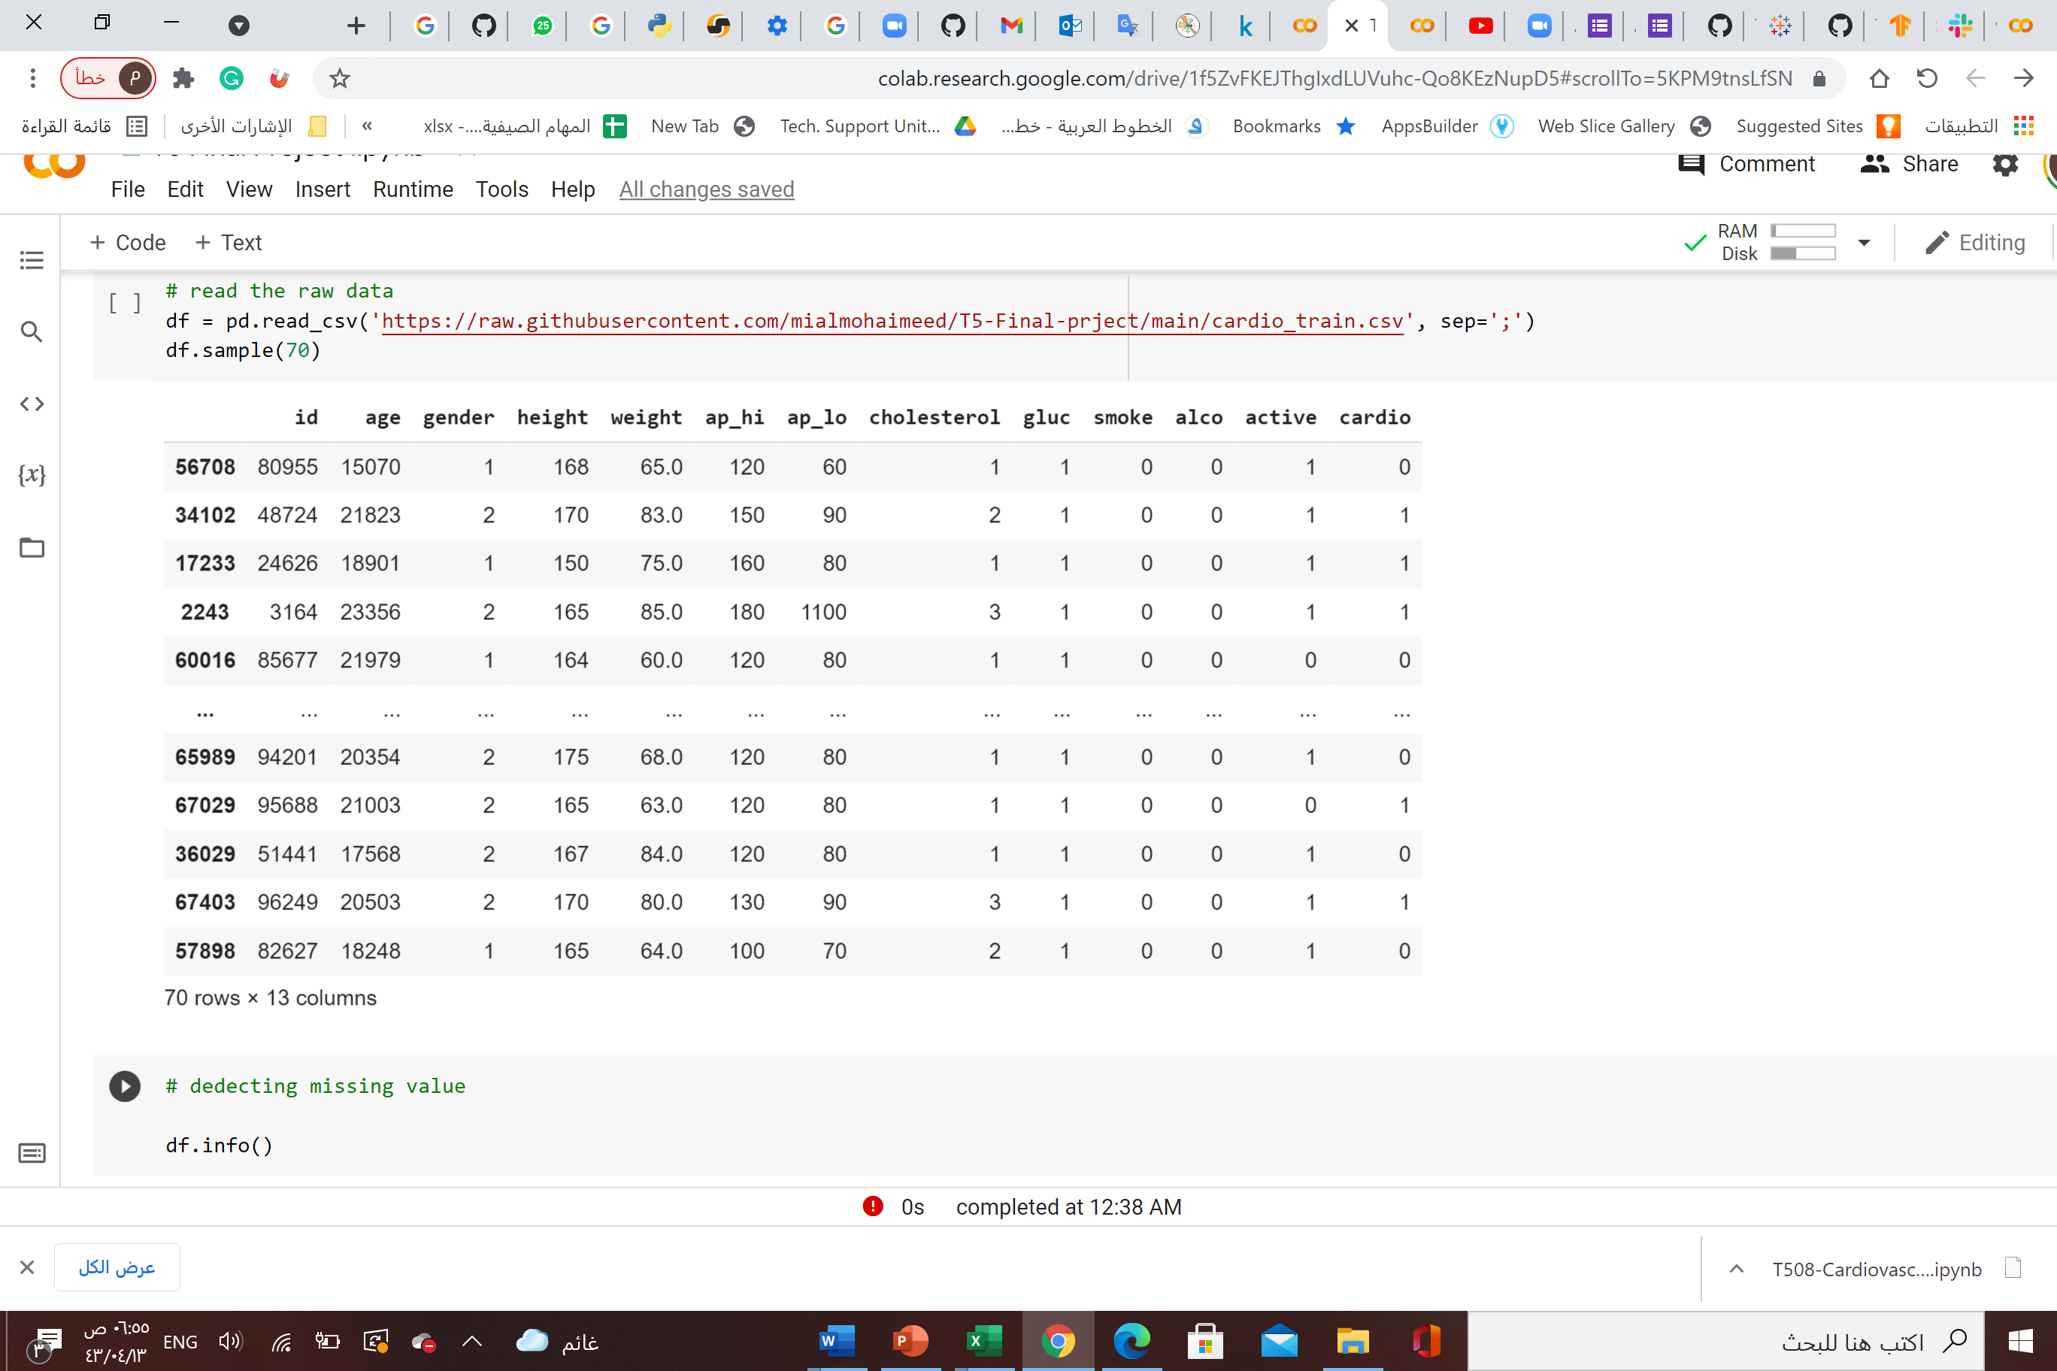
The dataset contains information about patients doing cardiovascular disease examination.

Slide 4
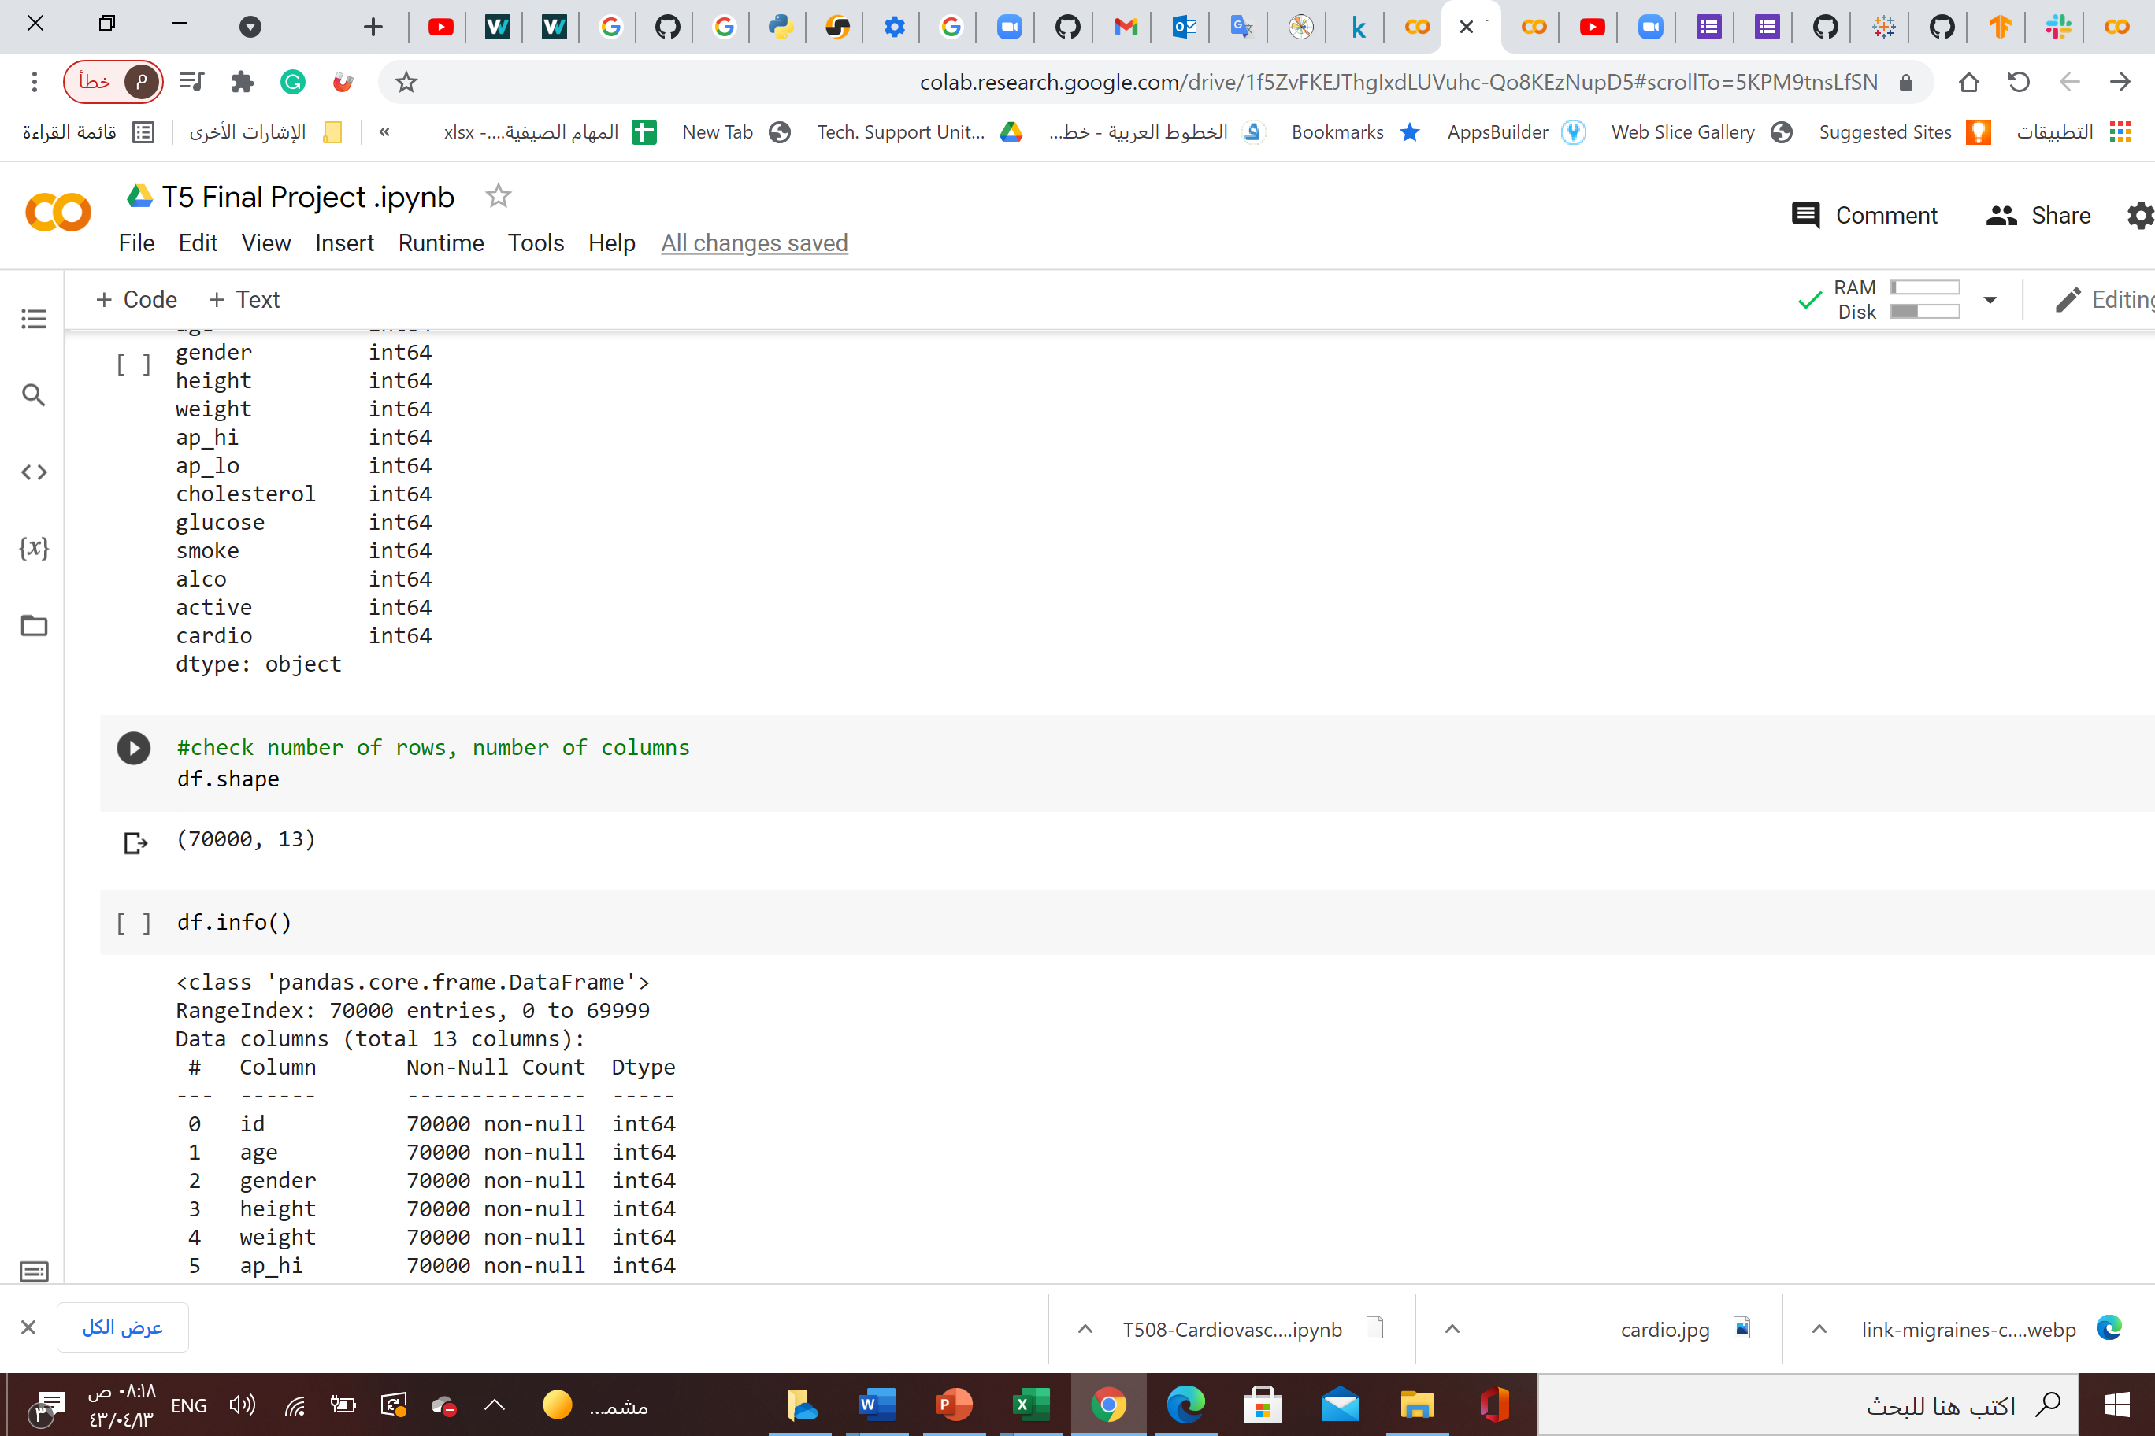
the number of rows and columns in dataset.

Slide 5
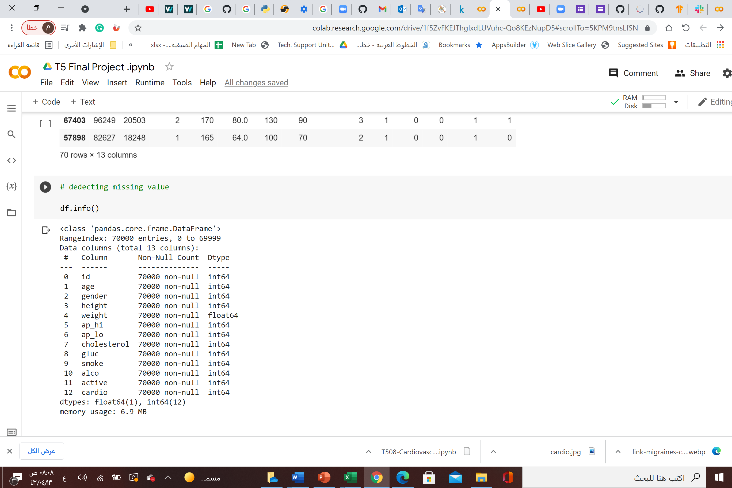
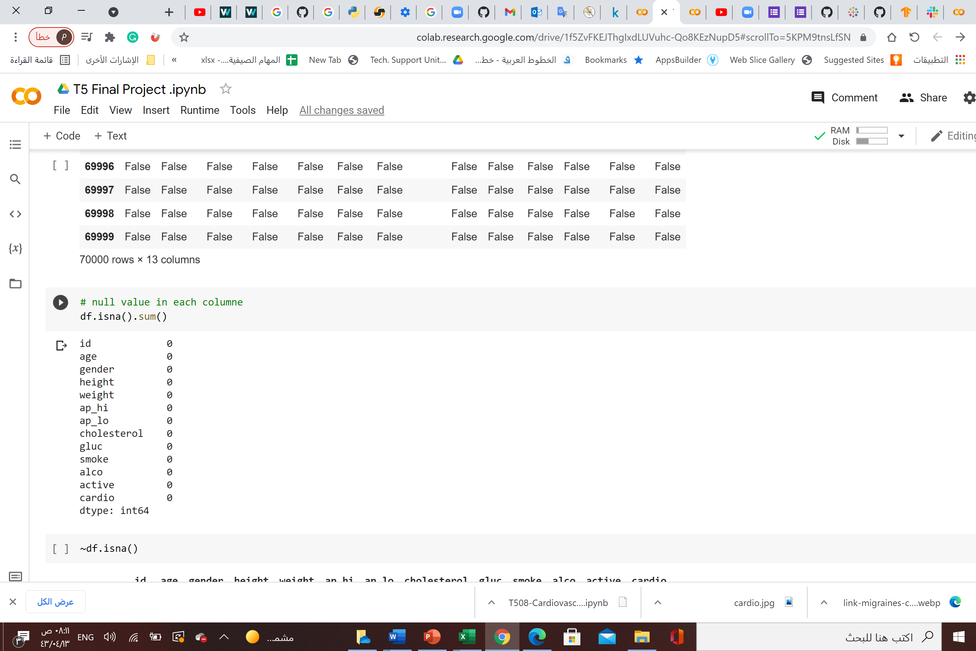
Checking if there's NULL value in any of the cells.
There are no missing values ☺ ☺

Slide 6
Checking if there's NULL value in each column.
There are no missing values ☺ ☺

Slide 7
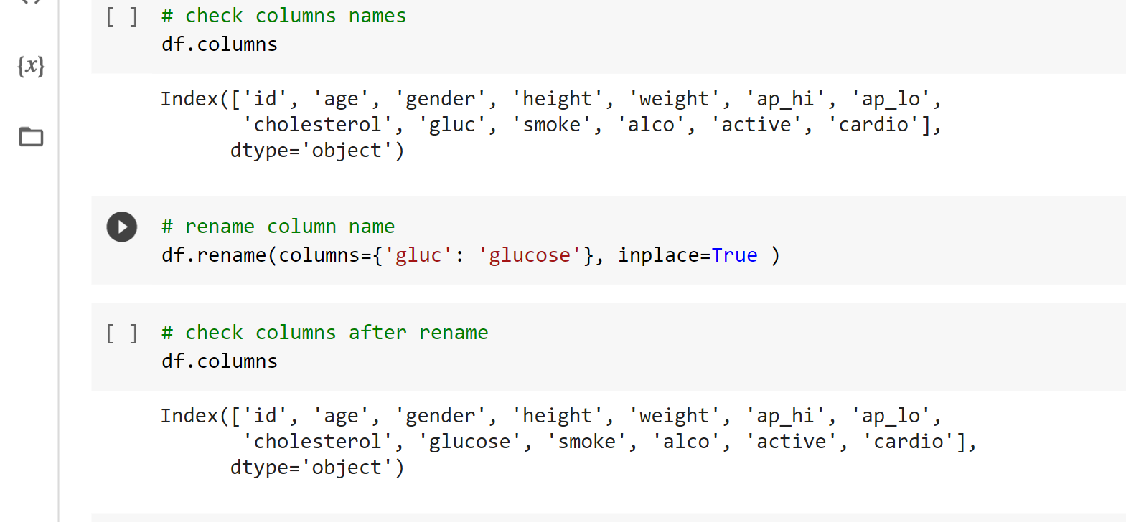
Checking the columns names
and rename “gluc”

Slide 8
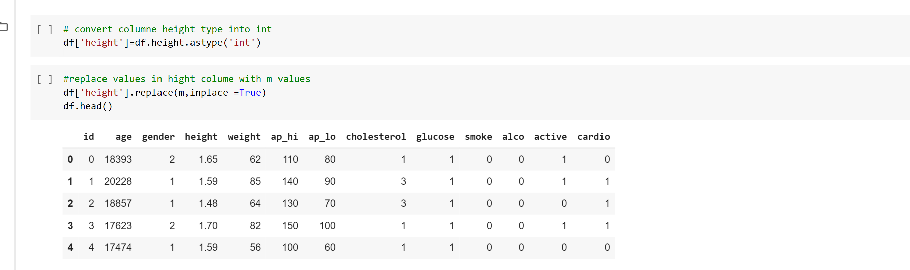
Calculate the BMI
Wight/height^2

Slide 9
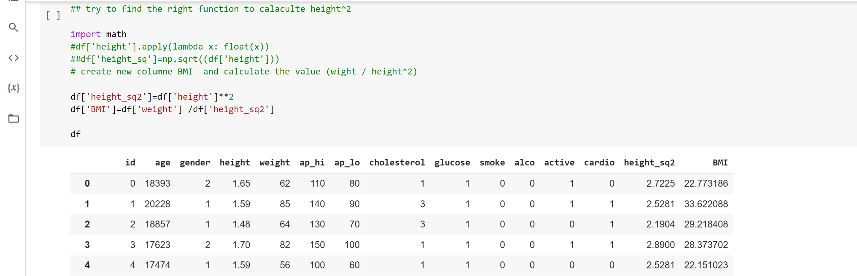
Calculate the BMI
Wight/height^2

Slide 10
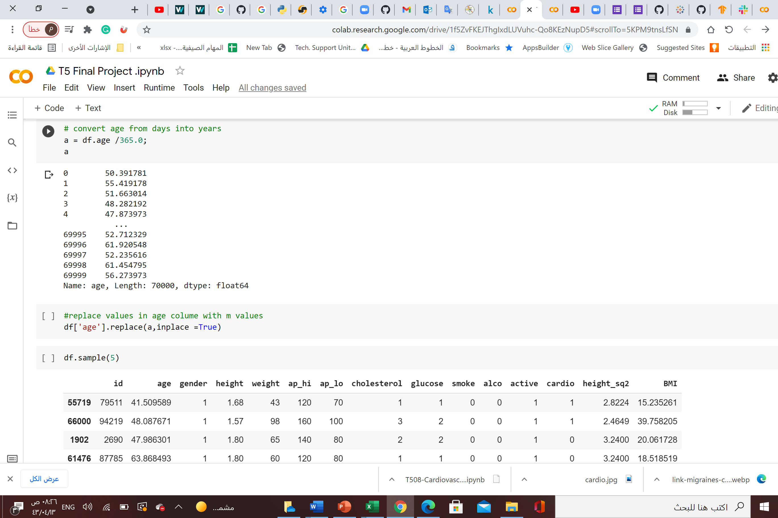
Converting age
From days to years

Slide 11
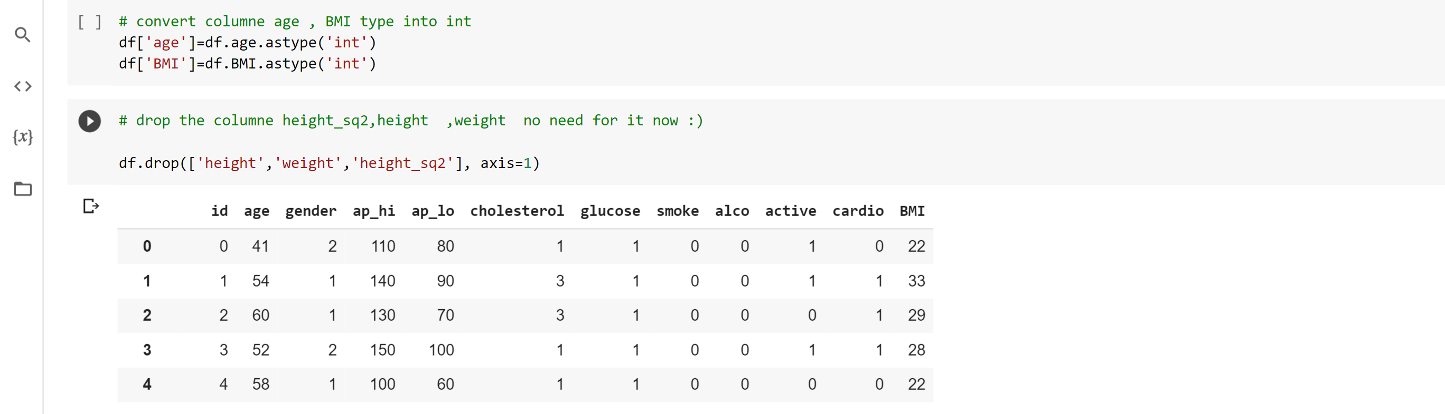
Converting age
From days to years

Slide 12
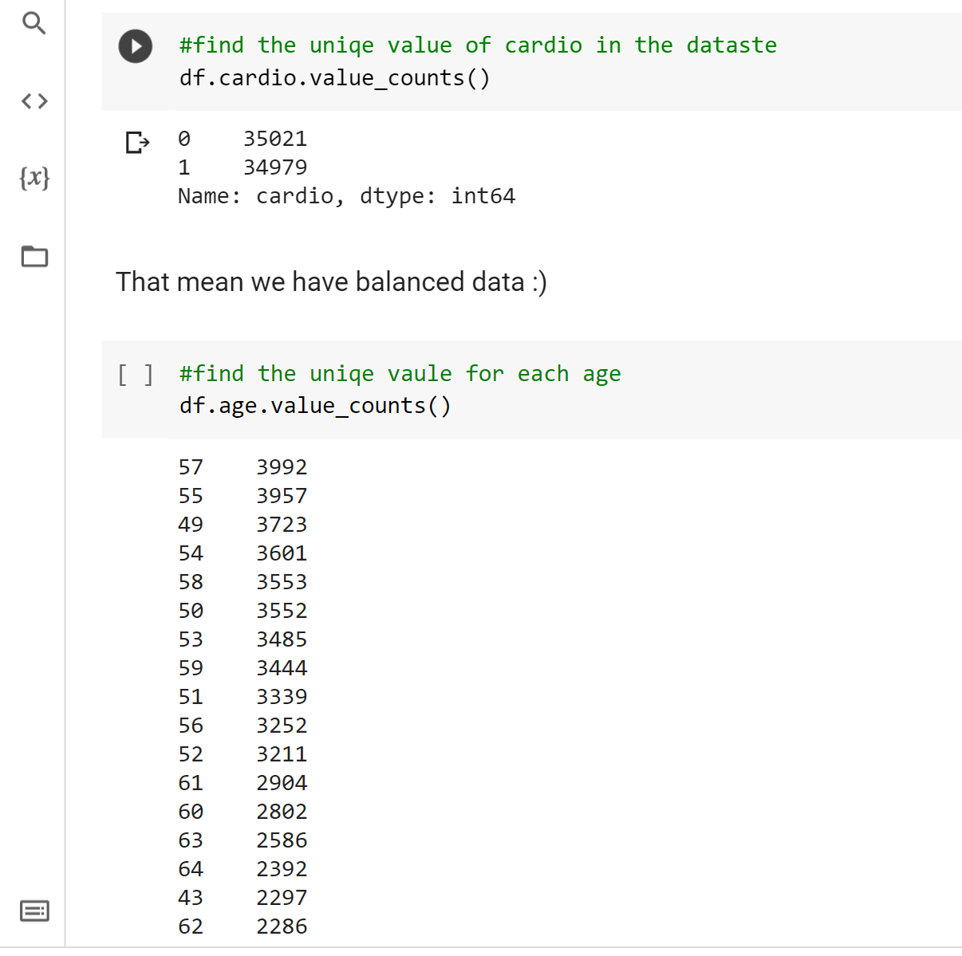
Find the unique value of cardio
We have balanced data☺ ☺

Slide 13
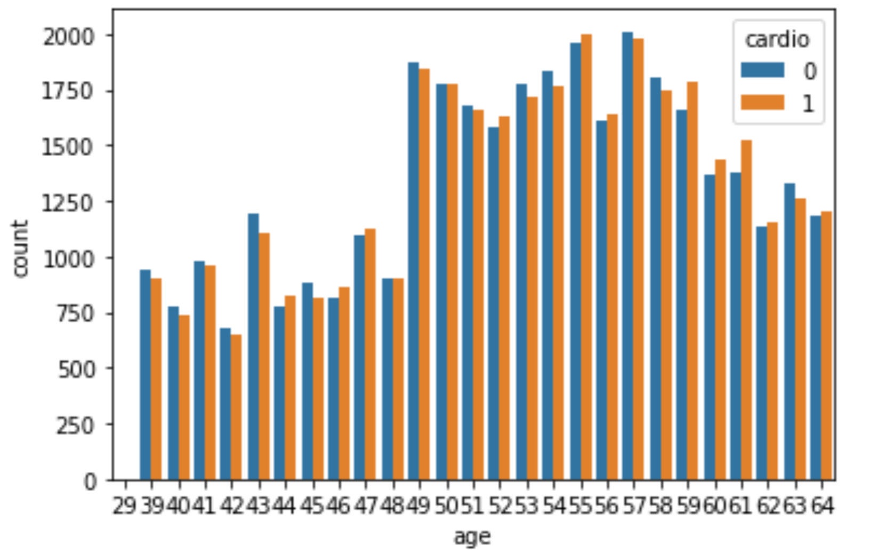
Find the most effected age
Almost the 50’s ☹

Slide 14
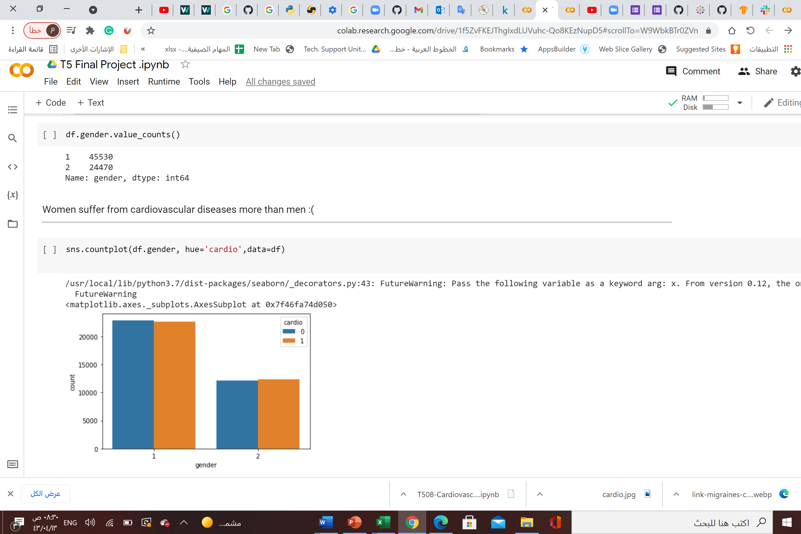
Find the most effected gendr
Women suffer
from cardiovascular diseases
more than men ☹☹☹

Slide 15
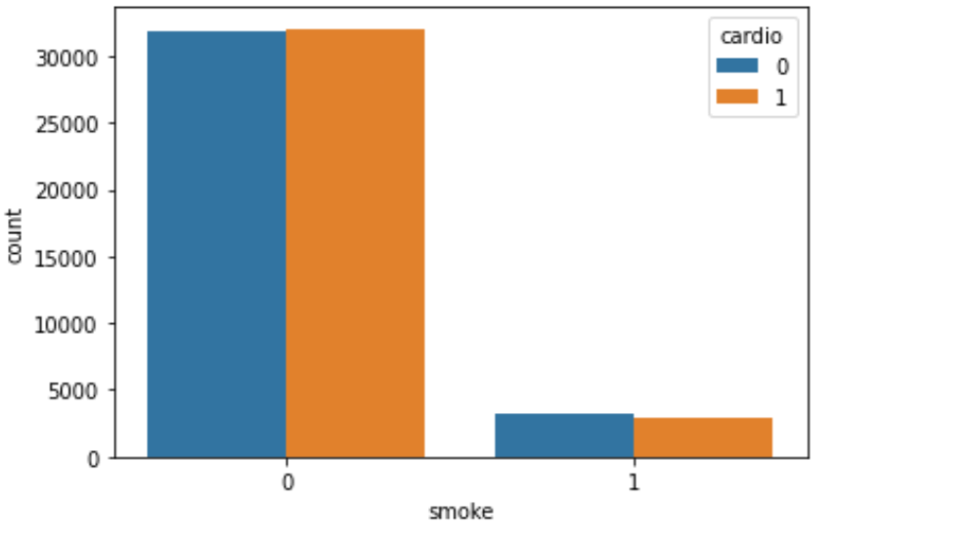
find if smoke affecting the occurrence of cardiovascular disease
!!

Slide 16
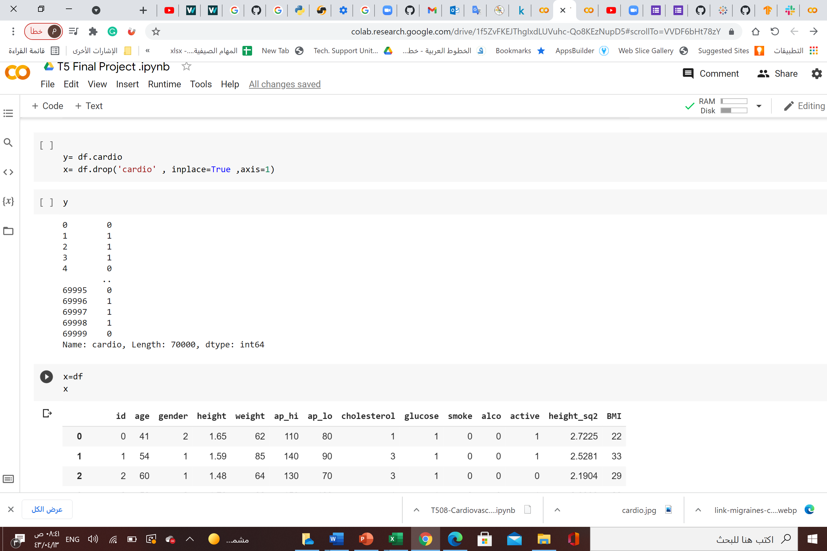
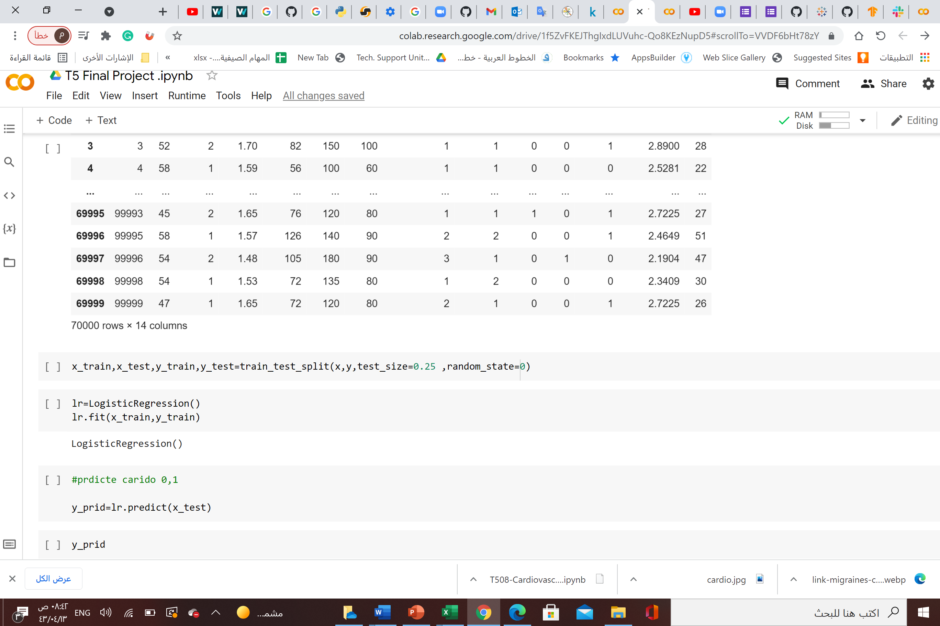
Converting age
From days to years

Slide 17
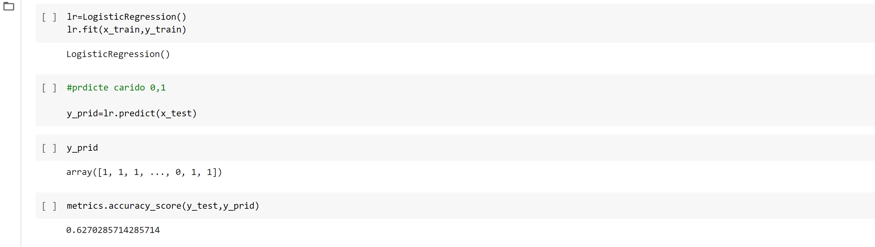
Logistic regression
Accuracy 62%

Slide 18
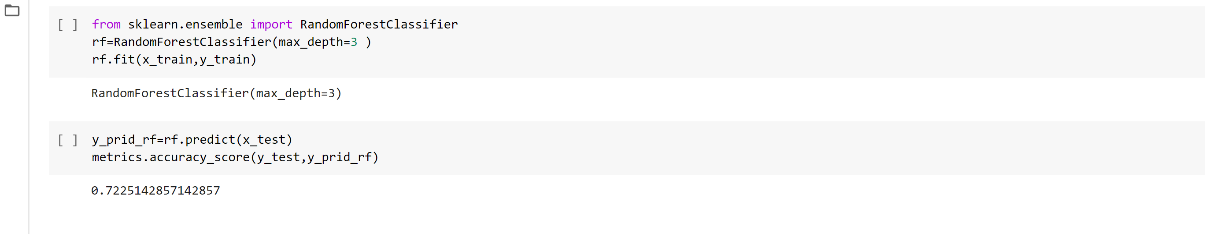
Random forest classifier
Accuracy 72%

Slide 19
Thanks ☺

